Slide 1





Avalonia UI
A short Introduction
Source: http://avaloniaui.net

Slide 2
What is Avalonia UI
Cross Platform UI Framework for .NET Framework, .NET Core and Mono (Windows, Linux, OSX, Android and iOS)
XAML
MVVM Binding through Reactive UI
Open Source (MIT) ☺

Slide 3
Architecture
.NET4.5+/Mono
.NET Core
AvaloniaUI (netstandard 2.0)
Bindings
Logical/Visual Tree
Renderer(s)
Controls
Styles
Etc.
IRuntimePlatform
Xamarin.*
Win32
Avalonia.Xaml (netstandard 2.0)
GTK#
GTK3
Avalonia.DefaultTheme (netstandard 2.0)
Xamarin.iOS
Xamarin.Android
…
IWindowingPlatform
Direct2D
IRenderingPlatform
Skia
Cairo
Source: https://github.com/AvaloniaUI/Avalonia/wiki/High-level-architecture-overview

Slide 4
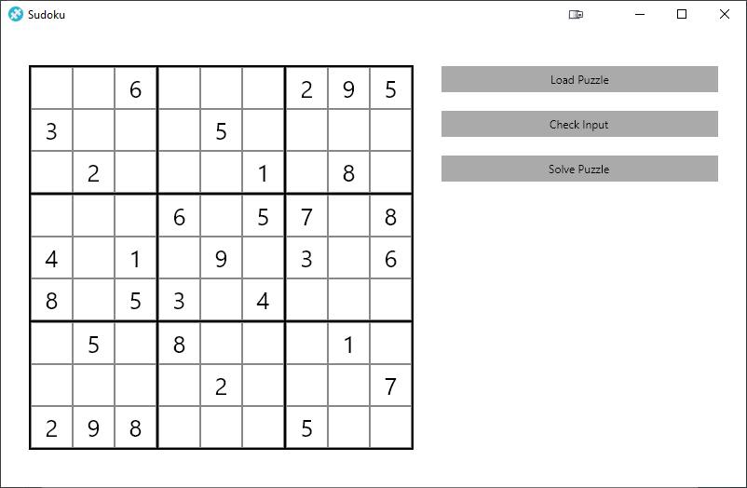
Implementing a Sudoku App

Slide 5
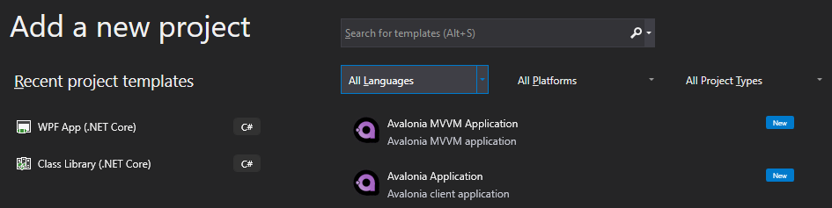
Creating the project
Option 1: Visual Studio Extensions
Option 2: .NET Core Template (available on Github)
> dotnet new avalonia.mvvm -o AvaloniaMvvmAppUI

Slide 6
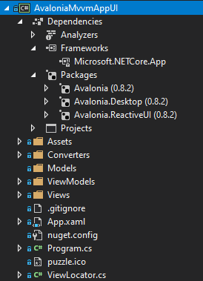
Project Structure
References to
Avalonia
Avalonia.Desktop
Avalonia.ReactiveUI
Folders for
Models
ViewModels
Views
ViewLoctaor

Slide 7
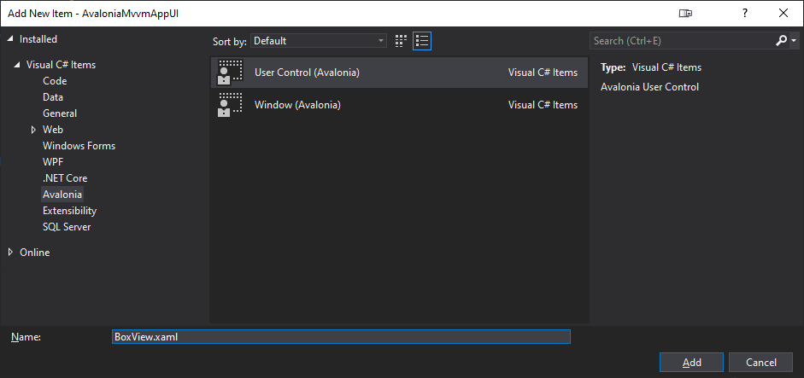
Creating the Control (Visual Studio)

Slide 8

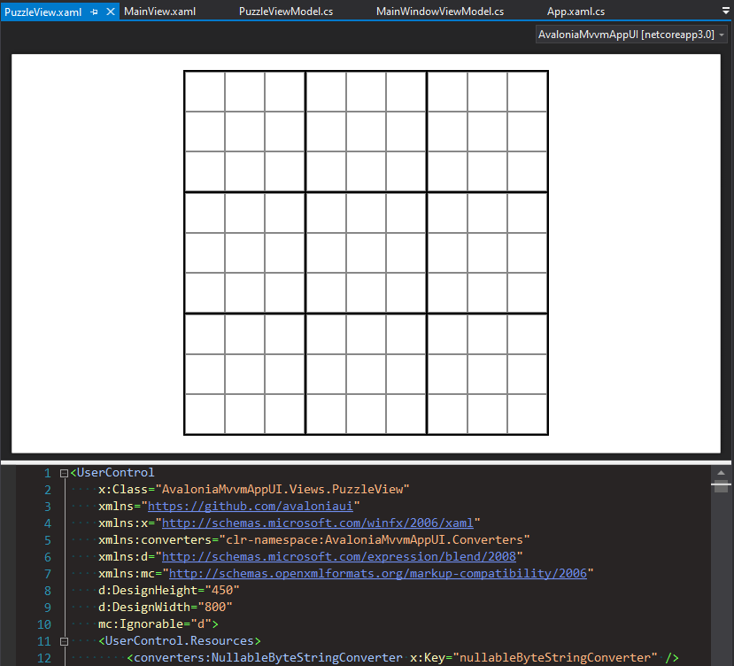
Creating the Control (XAML)
Styles
Converter
DataBinding

Slide 9
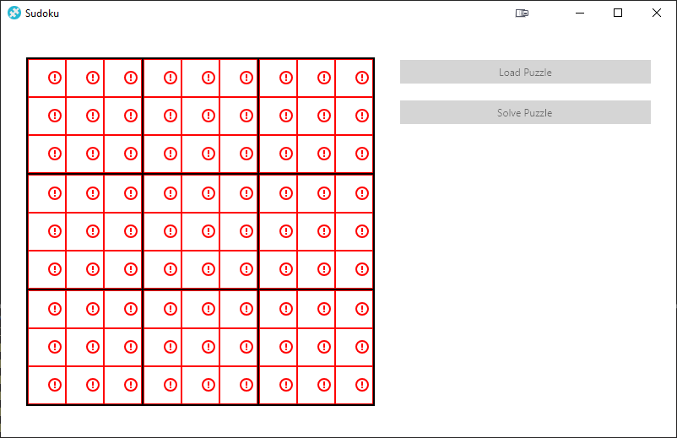
Data Binding

Slide 10
Command
No RelayCommand necessary
… <Button Command="{Binding LoadPuzzle}" Content="Load Puzzle" … /> …
public class MainWindowViewModel : ViewModelBase
{
public void LoadPuzzle()
{
this.PuzzleViewModel.Load(PuzzleProvider.SamplePuzzle1);
}
…
}

Slide 11
Supported Controls
Border
Button
Calendar
Canvas
Carousel
CheckBox
ContentControl
ContextMenu
Decorator
DockPanel
Expander
Grid
GridSplitter
Image
ItemsControl
LayoutTransformControl
ListBox
Menu
Panel
ProgressBar
RadioButton
RepeatButton
ScrollViewer
Separator
Slider
StackPanel
TabControl
TextBlock
Textbox
ToolTip
TreeView
UserControl
Window
WrapPanel

Slide 12
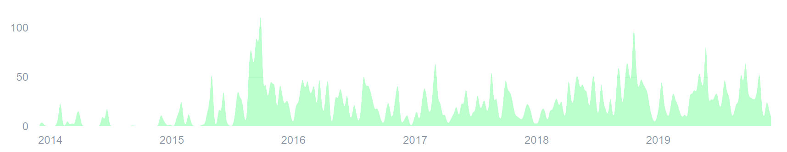
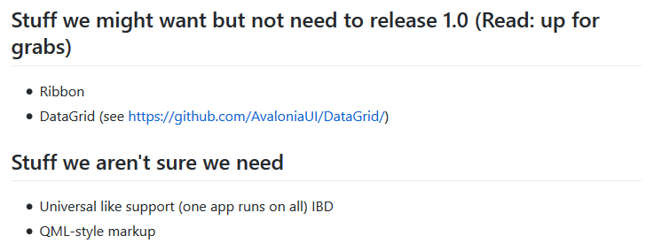
Roadmap
Alpha
Release 0.7
Release 0.8
Release 1
2014
2015
2018
2019
?
Source: https://github.com/AvaloniaUI/Avalonia/wiki/The-Plan

Slide 13
Conclusion
Pro
Con
Tutorial
Very WPF like
Documentation
Visual Studio Extensions
MVVM support
Debugging (code only)
Binding to public Method (no Command required)
Cross Platform
Not yet ready for comercial usage
Limited auto completion
No implicit type conversion
No Triggers
No DataGrid and other controls
No Helper Tools like Snoop
Controls are limited
No out of the box Internationalization support

Slide 14


Try it out! ☺
https://avaloniaui.net
https://github.com/mmarkovic/SudokuPlayground

